Slide 1

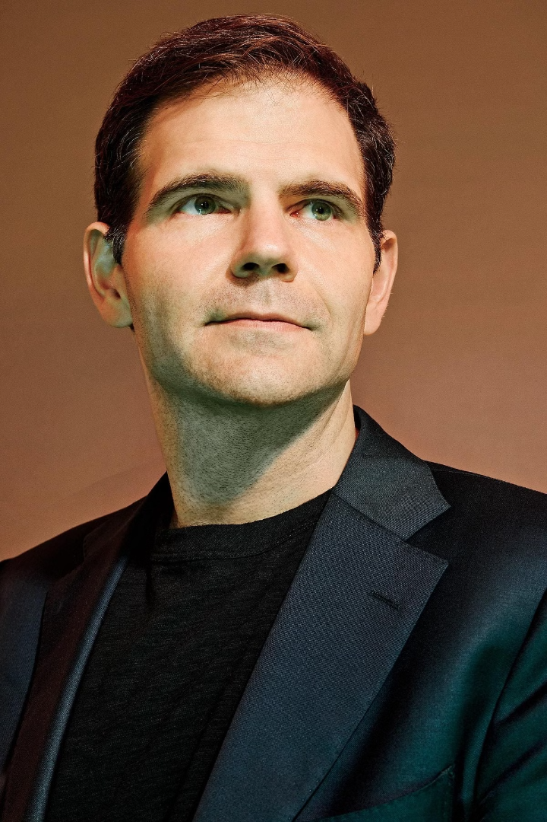


The AI Chip Boom Saved This Tiny Startup. Now Worth $2.8 Billion, It's Taking On Nvidia
Groq CEO Jonathan Ross named his company after the Martian word meaning “to understand with empathy,” from the sci-fi classic Stranger in a Strange Land. Elon Musk liked the word too, dubbing his AI chatbot Grok. “We call dibs,” Ross says.
by vaibhav kokare

Slide 2

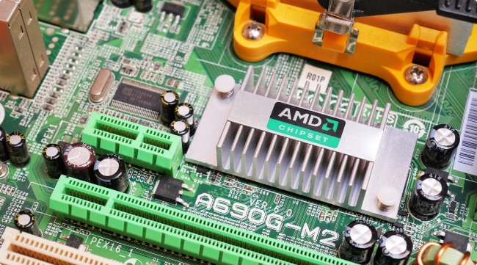
Groq's Rise
1
Early Struggles
Groq nearly died many times, facing financial difficulties and a limited market for its specialized AI chips.
2
ChatGPT's Impact
The release of ChatGPT in late 2022 sparked a global AI frenzy, creating a surge in demand for Groq's technology.
3
Series D Funding
Groq raised a $640 million Series D round, valuing the company at $2.8 billion, a significant increase from its 2021 valuation.

Slide 3
Groq's Focus: Inference
Inference
Nvidia's Dominance
Groq's Opportunity
Groq's chips are designed for "inference," the part of AI that applies learned knowledge to new situations.
Nvidia currently holds an 80% share of the AI chip market, with its GPUs originally designed for gaming.
Groq aims to capture a share of the growing inference market, estimated to reach $60.7 billion by 2027.

Slide 4

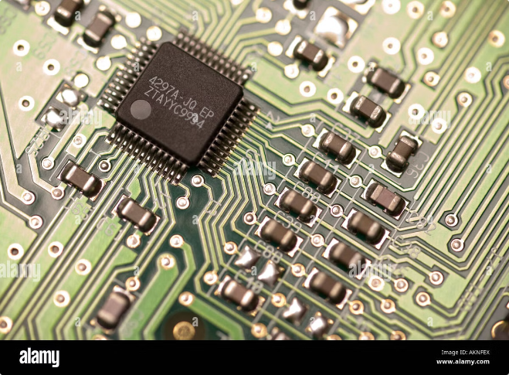
Groq's Technology: Language Processing Units (LPUs)
1
Speed
Groq claims its LPUs are four times faster than Nvidia's GPUs for inference.
2
Cost
Groq claims its LPUs are five times cheaper than Nvidia's GPUs for inference.
3
Energy Efficiency
Groq claims its LPUs are three times more energy efficient than Nvidia's GPUs for inference.
4
Validation
Investors and industry experts have praised Groq's inference speeds.

Slide 5

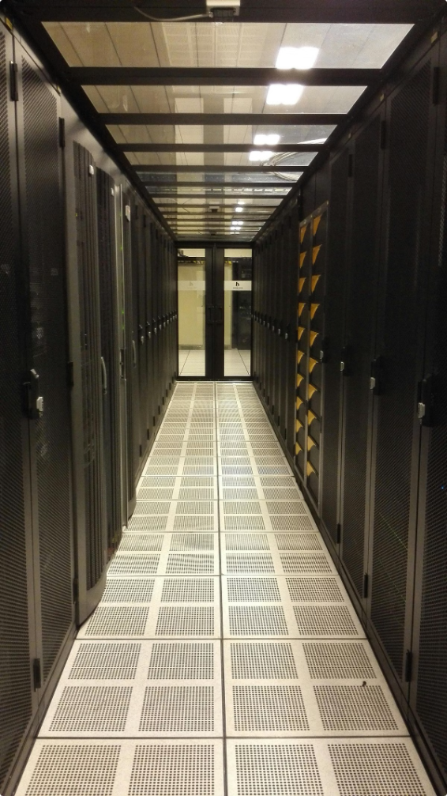
Groq's Customers
Argonne National Labs
Uses Groq chips to study nuclear fusion.
Aramco Digital
Partners with Groq to utilize its chips.
GroqCloud
Offers developers access to Groq's chips through a cloud platform.
Meta
Uses Groq chips to run inference for its new Llama 3.1 model.

Slide 6


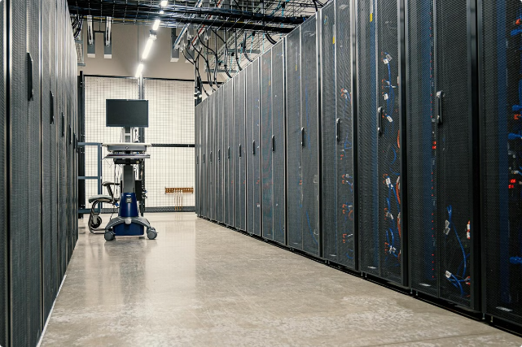


Groq's Future
Scaling Revenue
Groq is focused on increasing revenue and operations.
Competition
Groq faces competition from established players like Nvidia and Amazon.
Growth Potential
Groq's technology and market position offer significant growth potential.

Slide 7





Groq's Leadership
Jonathan Ross
CEO of Groq, with experience at Google and NYU.
Stuart Pann
COO of Groq, former Intel executive.
Yann LeCun
Meta chief scientist and technical advisor to Groq.

Slide 8


Groq's Challenges
Intellectual Property
Some investors question the long-term defensibility of Groq's technology.
Cost-Efficiency
Concerns about the cost-efficiency of Groq's chips at scale.
Market Share
Groq faces a significant challenge in capturing market share from Nvidia.

Slide 9
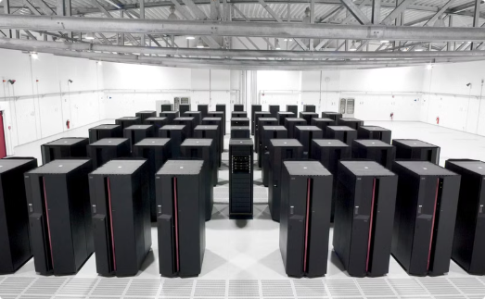
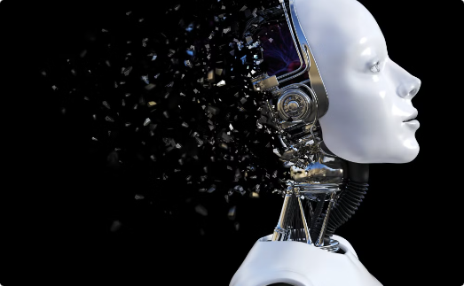
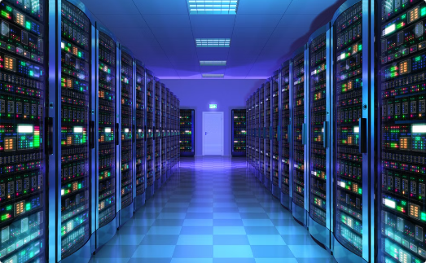
Groq's Potential
High-Performance Computing
AI Advancements
Cloud Computing
Groq's chips could revolutionize high-performance computing.
Groq's technology could accelerate advancements in artificial intelligence.
Groq's chips could transform cloud computing infrastructure.

Slide 10
The Rise of Language Processing Units (LPUs)
Even laptops are now incorporating specialized Language Processing Units (LPUs) for advanced natural language processing tasks.
These LPUs offer improved performance and energy efficiency compared to traditional CPUs and GPUs for inference workloads.
LPUs are designed to accelerate language-based AI models, powering features like voice assistants, chatbots, and language translation.
The adoption of LPUs signals a growing trend towards hardware specialization to meet the demands of modern AI and machine learning applications.
As AI continues to permeate our daily lives, the prevalence of LPUs will only increase, transforming how we interact with technology.

Slide 11
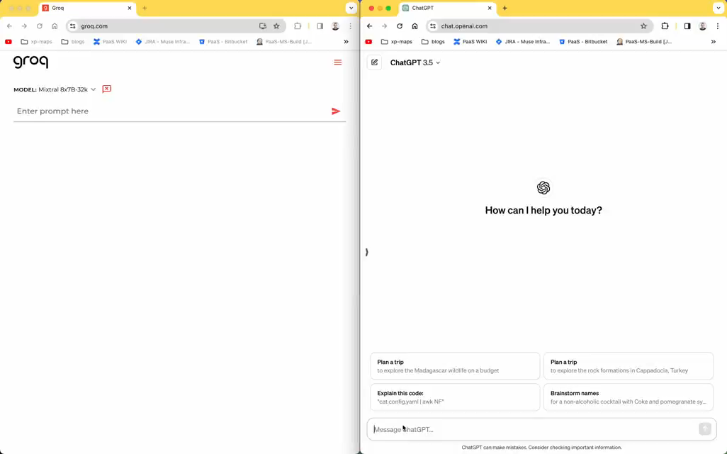

Slide 12
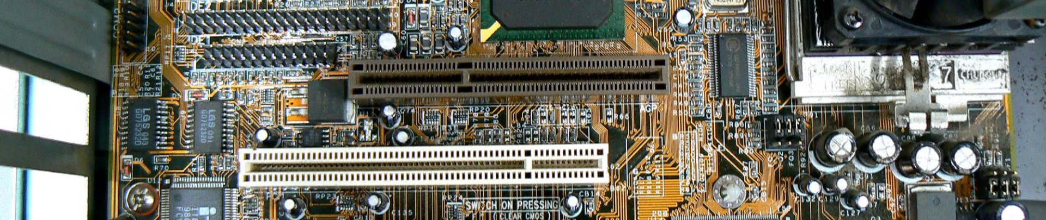
Groq's Future
Groq is a young company with a promising future. Its innovative technology and strong leadership position it well to compete in the rapidly growing AI chip market.

